Slide 1

US Incidence of Covid cases vs vaccination rates
Team 3: Rana Badri-Pena, Matt Lett, Zhuoli Ma, Nathan Weinberg

Slide 2

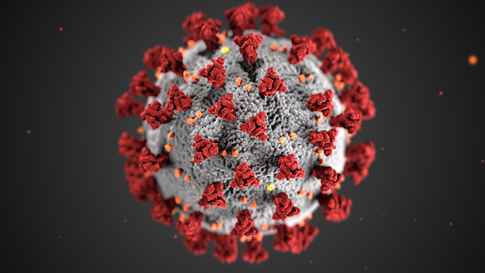
Motivation & Summary
Core Message: Using CDC data, try to examine the relationship between resurgence of Covid Cases in the United States versus State Vaccination Rates.
VS

Slide 3

Questions and Data Sources
The main question was how did state vaccination rates impact the resurgence of covid over time?
The majority of our data was sourced from the CDC website: https://www.cdc.gov/nchs/covid19/
Daily Data on Vaccination Rates (by US County, State)
Daily Data on Covid Cases reported by each State
State Population data (as of 2019)

Slide 4

Data Cleanup and Exploration
Data Cleanup consisted of 3 phases:
Importing, fixing and selecting relevant data in Jupyter Notebook (pandas)
Enhancing summaries in Excel using vba
Summarizing and then plotting data in Jupyter Notebook (matplotlib)

Slide 5
Data Cleanup and Exploration cont…
Data anomalies:
Some data was not related to the 50 United States (and DC), so we decided to filter our efforts by only including the 50 State Codes and DC. (Territories like PR and GU were filtered out).
The vaccination data was cumulative, i.e. each state reported daily on their total number or vaccinated people as of that date. We needed data that showed the number of newly reported vaccinations each day, so we relied on vba coding in Excel to extrapolate that information.
We decided to focus on weekly figures, so we had to adjust the week numbers so that they were consecutive. (for example, with vaccinations starting in December, those weeks (like 53, 52, 51 of 2020) needed to be adjusted so that we could graphically represent the weeks in order from a smaller number, to the biggest number.
Data for vaccinations was raw numbers of people, so we needed to extrapolate a population percentage in order to make meaning for each state and allow for comparisons. Thus, the state populations was merged with the Vaccination totals to get the vaccinated percentage.

Slide 6
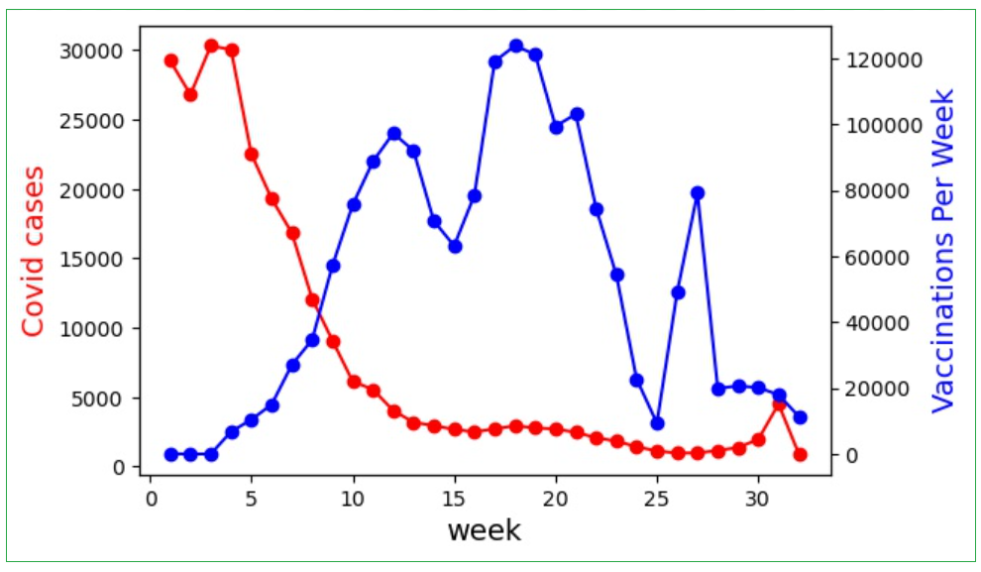
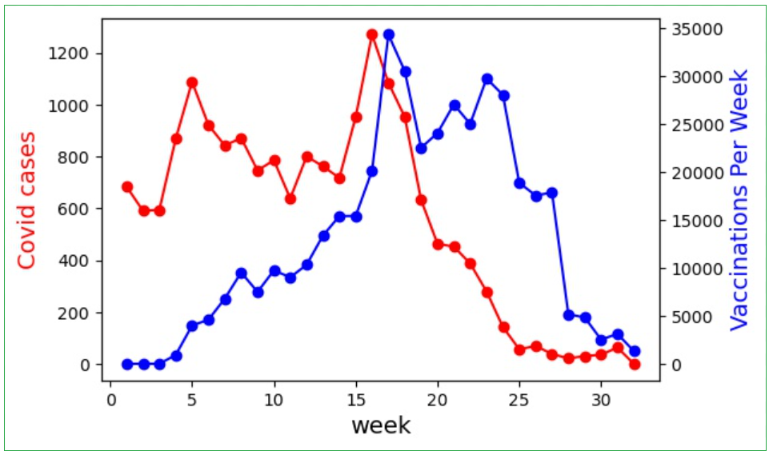
Data Analysis
5 Least Vaccinated States (Summed)
5 Most Vaccinated States (Summed)

Slide 7
Post Mortem
Include more information regarding Vaccine Hesitancy, which we did have, but didn’t have a chance to incorporate.
More statistical numerical analysis of the comparisons between states.
Updated data that is more current.

Slide 8

Questions???

